Slide 1
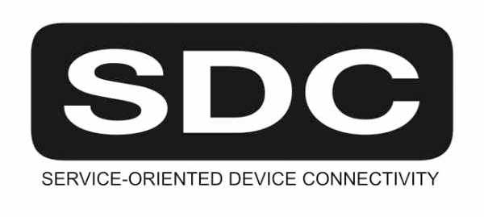


IHE Germany SDC / SDPi Plug-a-Thon -
Overview Briefing
20-21 October 2020
SDC is a registered trademark of OR.NET
(Version 1.1 2020.10.21A)

Slide 2
IHE Germany – SDC / SDPi Plug-a-Thon – Briefing
IHE Plug-a-Thon Basics
From ISO/IEEE 11073 SDC to IHE SDPi to PATs & CATs
Orientation Tour: IHE Technical Framework & SDPi Profiles
Real-world Narrative: Pandemic Patients in an Isolation ICU
SDC/SDPi PAT – Objectives

Slide 3
First … Term Usage & Assumptions
SDC Service-oriented Device Connectivity Family of ISO/IEEE 11073 SDC standards Assumption: PAT participants have a working understanding of SDC
SDPi Service-oriented Device Point-of-care Interoperability Set of (4) IHE technical framework profiles based on ISO/IEEE 11073 SDC standards Assumption: PAT participants may have some working knowledge of IHE & TF profiles
PAT Plug-a-thon IHE testing event intended for early, informal exploration of new tech & new profiles Assumption: PAT participants may have background in “hackathons”, plugfests, etc.
CAT Connectathon IHE formal interoperability testing event for published profiles; includes independent monitors, test management tooling; published results Assumption: PAT participants may have background in formal test invents

Slide 4
Second … Profiles? Why?!
IHE Profile A technical specification that constrains a set of general open standards for application to a specific interoperability or integration need (described by a set of use cases) ¹
Why profiles?
As users and implementers agree how to use standards to address specific integration needs, optionality must be minimized, coordinated usage of multiple standards considered, and national / regional allowances factored
Isn’t a well architected family of standards sufficient?
The needs of an implementation community are often both narrower than the set of possible applications that are covered by foundational / core standards, such as ISO/IEEE 11073 SDC, as well as broader in scope requiring additional standards to be integrated.
¹ Not to be confused with an HL7 FHIR Profile, which is similar in concept but very different in application

Slide 5
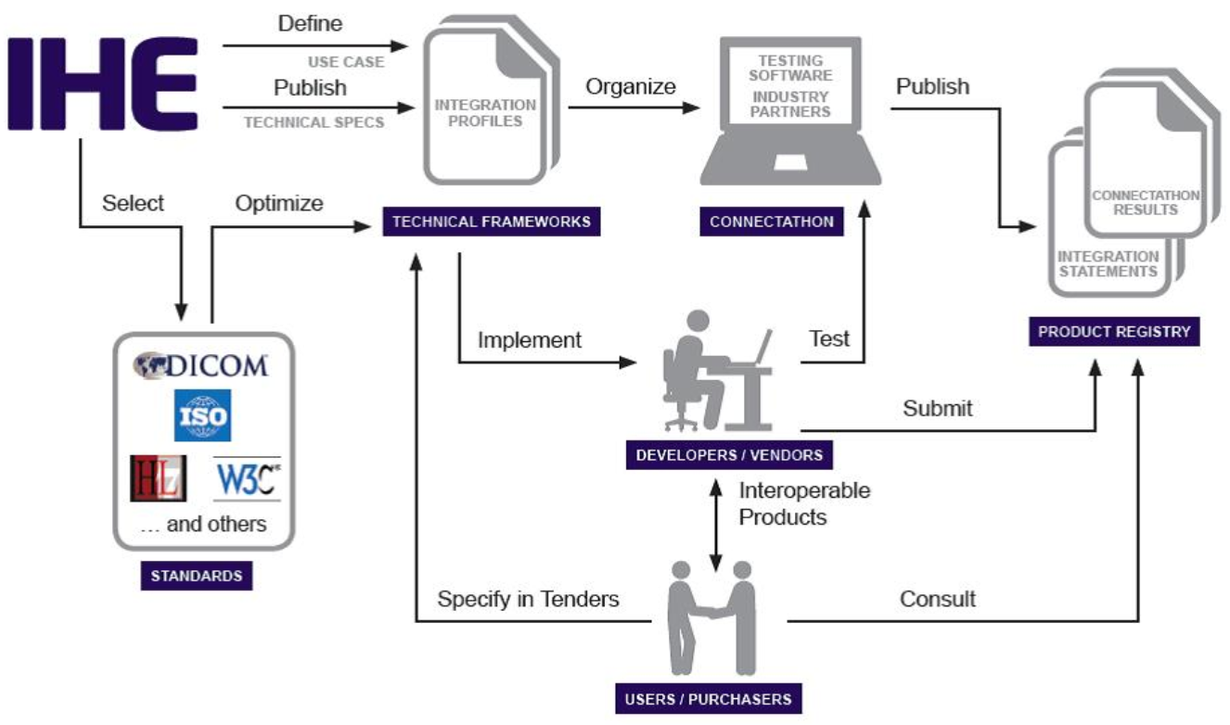
IHE Process Overview
Source: https://www.ihe.net/about_ihe/ihe_process/

Slide 6
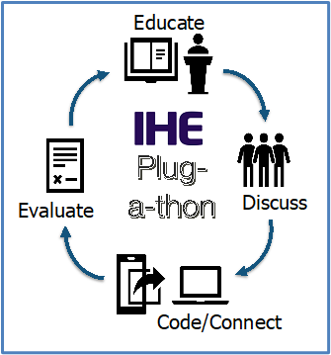
IHE Plug-a-thon (PAT) Basics
IHE Testing Events –
Pathway to CA & Certification!

Slide 7
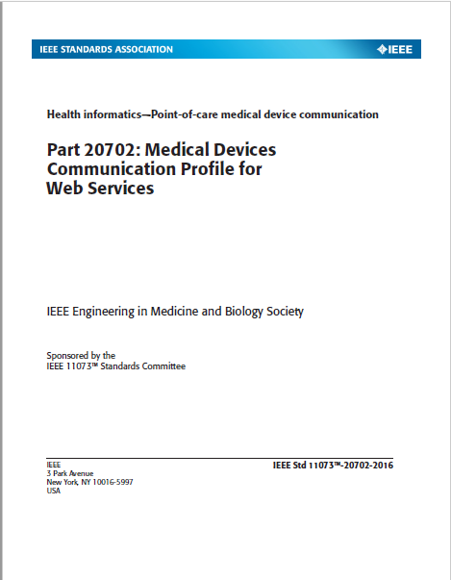
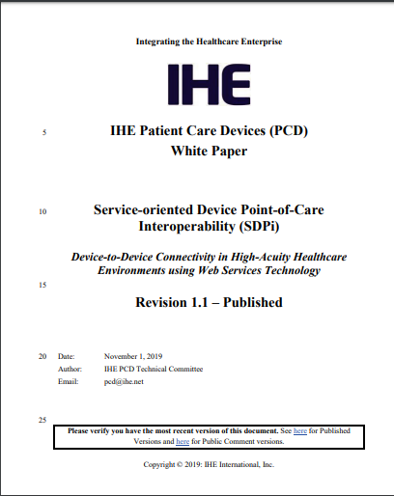
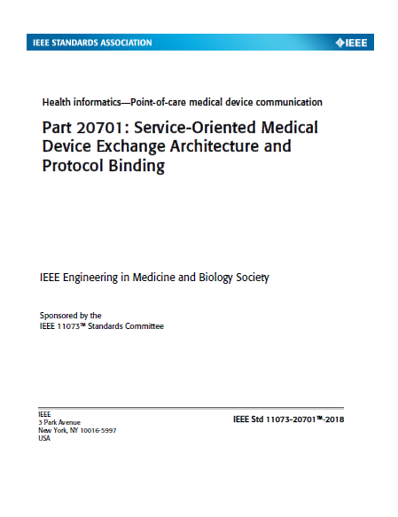
Orientation Tour: IHE TF & SDPi Profiles
2019 SDPi paper established rationale and strategy for profiling ISO/IEEE 11073 SDC in IHE Technical Framework profile specifications.
https://www.ihe.net/uploadedFiles/Documents/PCD/IHE_PCD_WP_SDPi_Rev1-1_Pub_2019-11-01.pdf
https://wiki.ihe.net/index.php/SDC@IHE_White_Paper

Slide 8
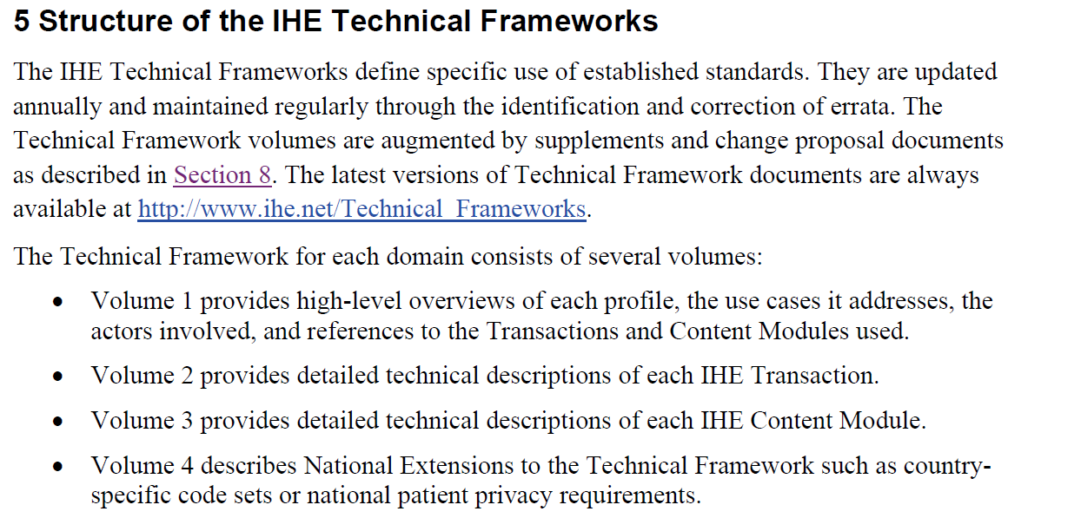
Orientation Tour: IHE TF & SDPi Profiles
Source: https://www.ihe.net/uploadedFiles/Documents/Templates/IHE_TF_General_Introduction.pdf

Slide 9
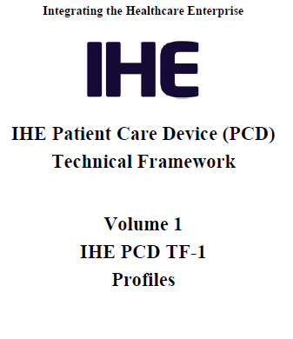
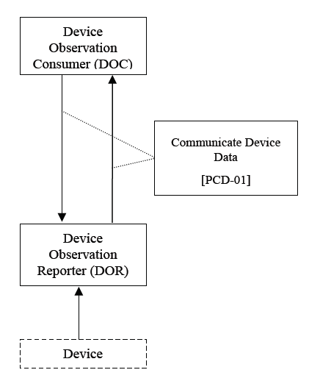
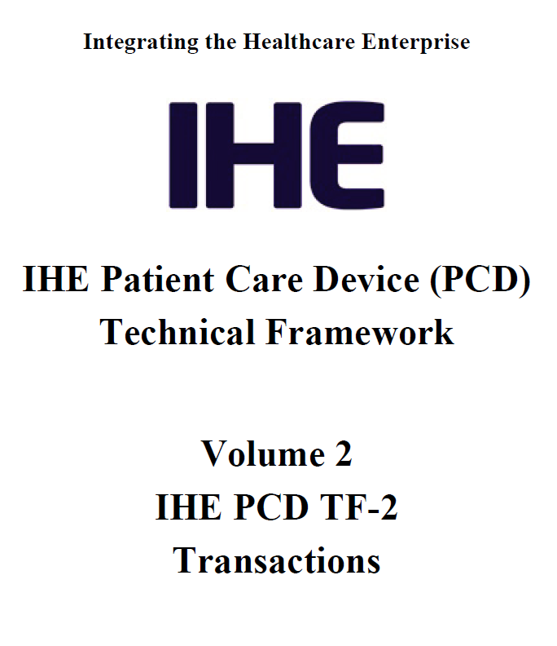
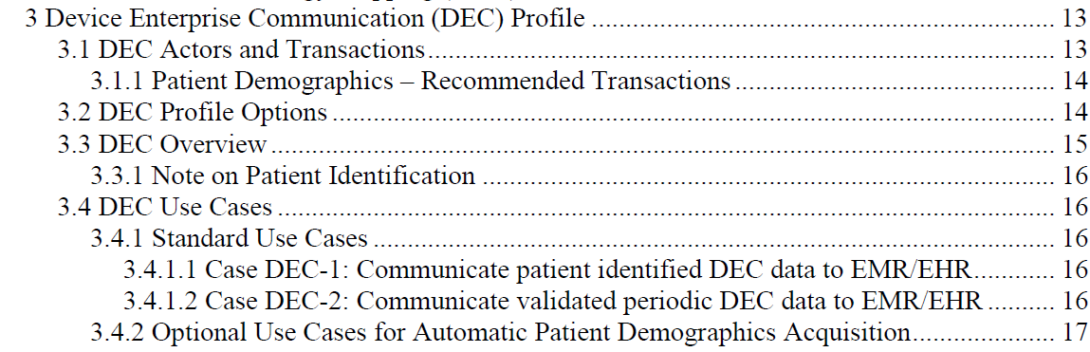
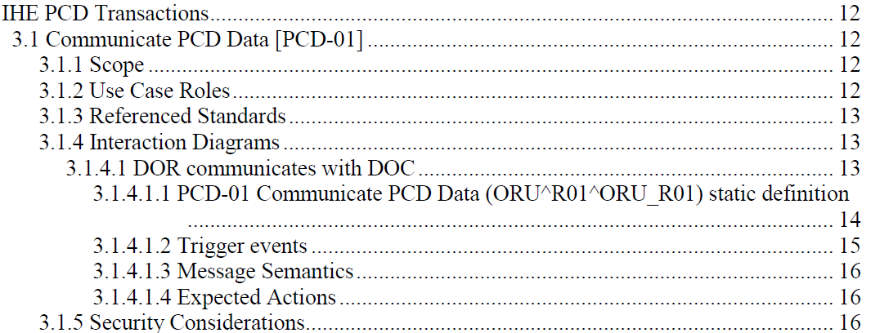
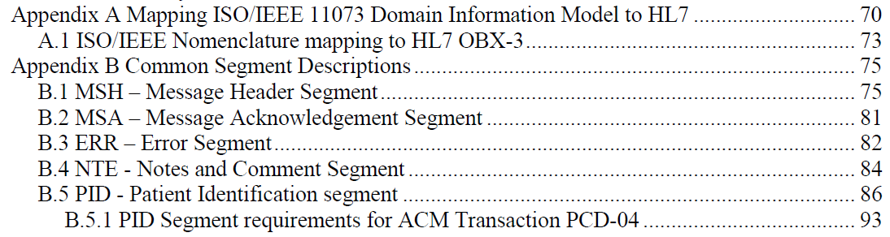
Orientation Tour: Example – IHE DEC Profile
TF-1 Profile calls out TF-2 Transaction(s) – may add usage constraints
TF-2 Common Transaction Message Elements Specified Once in Appendices
NOTE: Only message profiling specifications included, relying on references to base message standards for all additional details.

Slide 10
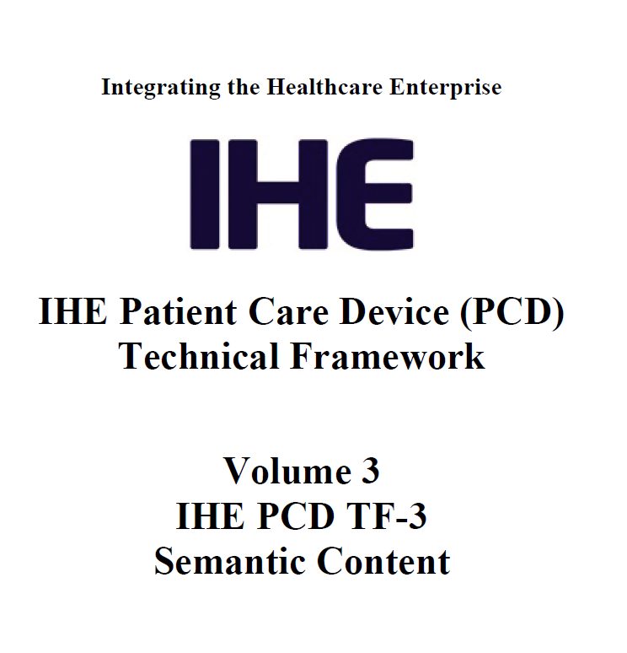
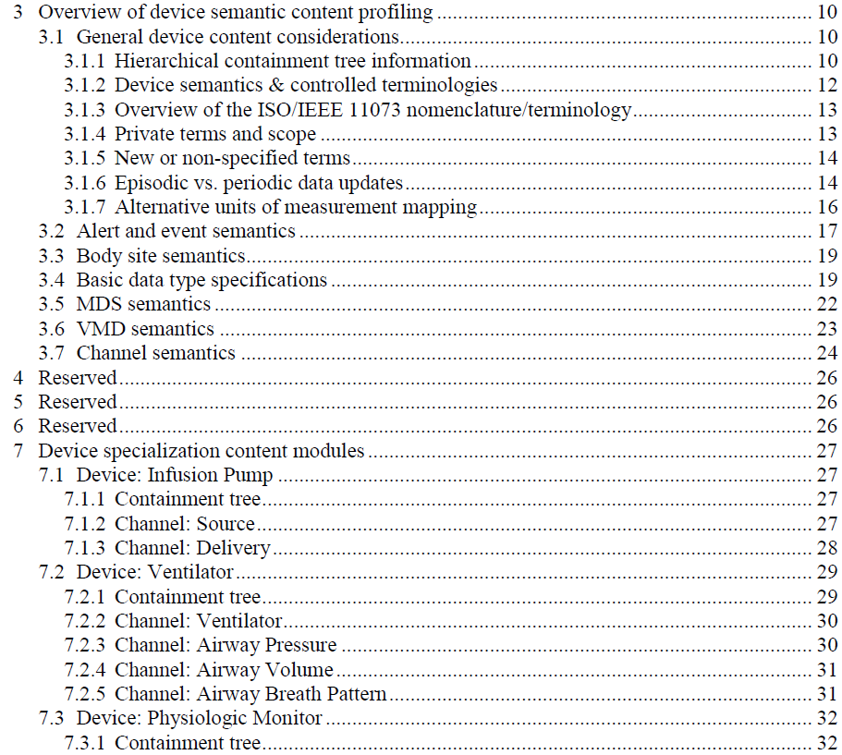
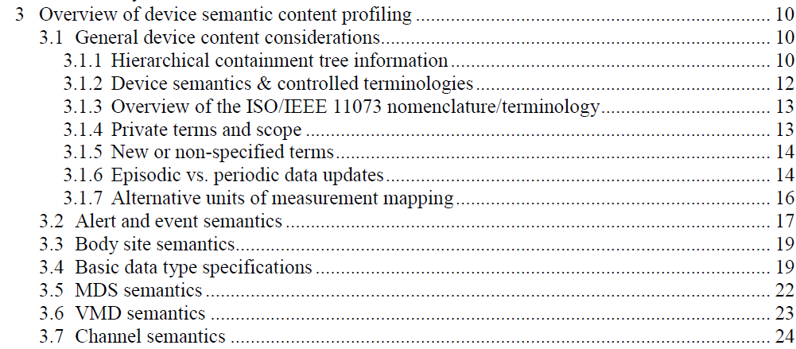
Orientation Tour: Example – IHE DEC Profile
TF-3 Bindings only generally specified in DEC profile & DEV-01 Transaction

Slide 11
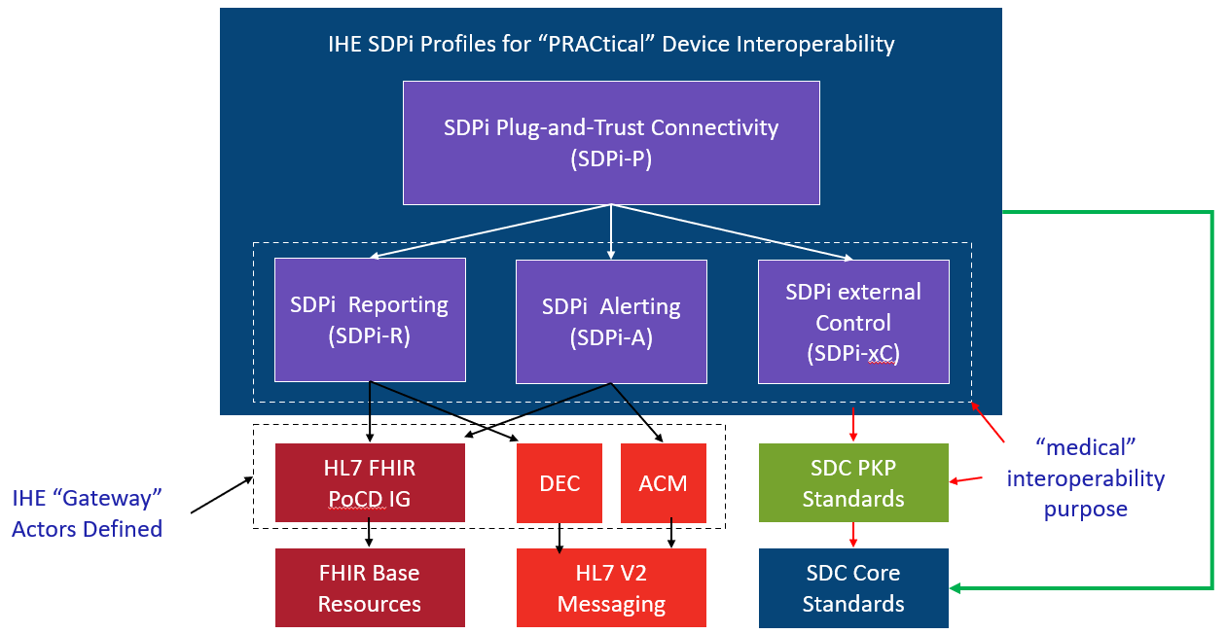
Orientation Tour: IHE TF & SDPi Profiles
Service-oriented Device Point-of-care Interoperability (SDPi)
Four profile specifications:
SDPi-P for Plug-and-Trust Interoperability
SDPi-R for Reporting Medical Information
SDPi-A for Alerting
SDPi-xC for External Controlling
Three IHE DEV TF Volumes:
TF-1 Profiles / use cases / actors / …
TF-2 Transactions / MDPWS messaging
TF-3 BICEPS content modules / device specializations
See draft SDPi Supplement Word Document for additional content detail & outline (https://github.com/IHE/sdpi-fhir/tree/master/SDPi%20%20Supplement/SDPi%20Rev%201.0)

Slide 12
Orientation Tour: From Volume 1 to 2 to 3
SDPi TF Supplement Vol.1 Integration Profiles
SDPi-P Profile
Profile Actors & Transactions & Content Modules
Profile Actor Options
Profile Overview (Concepts & Use Cases)
SES Considerations
SDPi-Reporting Profile …
SDPi-Alerting Profile …
SDPi-xControl Profile …
Appendix A: Requirements Management for Plug-n-Trust Interoperability
Appendix B: ISO/IEEE 11073 SDC Requirements Coverage
<including ISO/IEEE 11073 SDC ICS tables>
Appendix C: Device Point-of-care Interoperability Use Cases
<including Gherkin detail & links to Compendium etc.>
SDPi TF Supplement Vol.2 Transactions
DEV-23 Announce Network Presence
Scope
Actor Roles & Referenced Standards
Messages (at BICEPS level w/ links to Appendix A)
Protocol Requirements
SES Considerations
DEV-24 Discover Network Participants
…
DEV-44 Invoke Medical Control Services
Appendix A: ISO/IEEE 11073 SDC / MDPWS Message Specifications (Normative)
SDC/BICEPS to SDC/MDPWS Message Specifications
Messages for BICEPS Discovery Model
<specific MDPWS message links>
<example exchanges & library calls>
MDPWS Message Detail in Appendix
M:N Profiles & Transactions
See SDPi Supplement (1.0) document in the IHE sdpi-fhir Github repository for full details.

Slide 13
Orientation Tour: From Volume 1 to 2 to 3
SDPi TF Supplement Vol.1 Integration Profiles
SDPi-P Profile
Profile Actors & Transactions & Content Modules
Profile Actor Options
Profile Overview (Concepts & Use Cases)
SES Considerations
SDPi-Reporting Profile …
SDPi TF Supplement Vol.3 Content Modules
DEV Semantic Content Modules
General Device Content Considerations
…
SDC / BICEPS Semantic Content
DEV Specialization Content Modules
Device: Infusion Pump
…
SDC / BICEPS Content Module
Device: Ventilator …
Device: Physiologic Monitor …
Devices: Surgery … (new)
Devices: Anesthesia … (new)
Devices: Dialysis … (new)
SDPi TF Supplement Vol.2 Transactions
DEV-23 Announce Network Presence
Scope
Actor Roles & Referenced Standards
Messages (at BICEPS level w/ links to Appendix A)
Protocol Requirements
SES Considerations
DEV-24 Discover Network Participants
…
Bindings – General & Specific
See SDPi Supplement (1.0) document in the IHE sdpi-fhir Github repository for full details.

Slide 14
Orientation Tour: From 11073 SDC to SDPi
<diagram with cathedral & where specific standards content is profiled in TF-1 & TF-2 & TF-3>
BICEPS MDPWS SOMDA PKP SPECIALIZATIONS

Slide 15
Orientation Tour: From 11073 SDC to SDPi
Initially, map to TF-3 DEV Content Modules / Device Specializations
Can include content before specializations published
Eventually, may inform IHE DEV Device-Specific Profiles
Pre-publication, will reference in SDPi SES sections (TF-1, -2 & -3)
Post-publication, can fully integrate requirements into SDPi (incl. TF-1 Appendix B conformance)
NOTE: (4) profiles are aligned with these (4) key purposes
SDC/BICEPS (-10207) Referenced in all (3) volumes (TF-1, -2 & -3)
SDC/SOMDA (-20701) Referenced in TF-1 & TF-2
SDC/MDPWS (-20702) Referenced primarily in TF-2 (esp. Apdx. A)

Slide 16
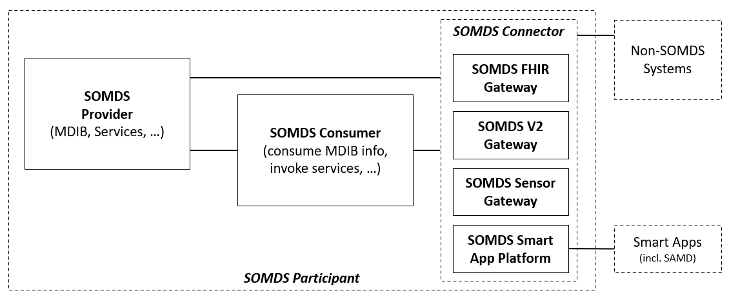
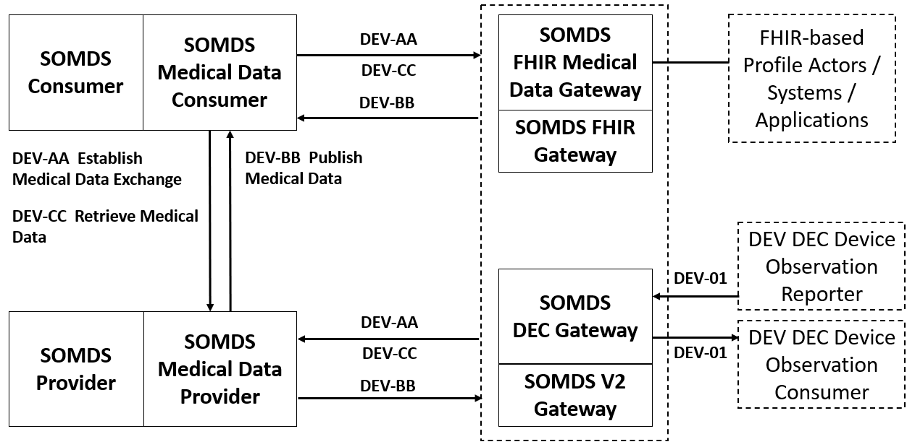
Orientation Tour: IHE Profile Actor Diagrams
IHE Actor
“information systems or components of information systems that produce, manage, or act on health information”
IHE Abstract Actor
Specifies behavior that is shared across / inherited by a set of IHE Actors (actor name in italics & dotted line around concrete actors)
Profile “External” Actor
Indicates actors that are outside the scope of the profile but interact with profile actors (dotted box) Note: actor may be defined in other profiles
IHE Grouped Actor
Indicates actors that integrate with other actors to provide their functionality (two rectangles joined side-by-side)

Slide 17
Orientation Tour: SDPi-P (Plug-and-Trust)
SDPi-P Actor Model
NOTE: SOMDS Participant actors may be devices, system applications, SAMD, “smart apps” …

Slide 18
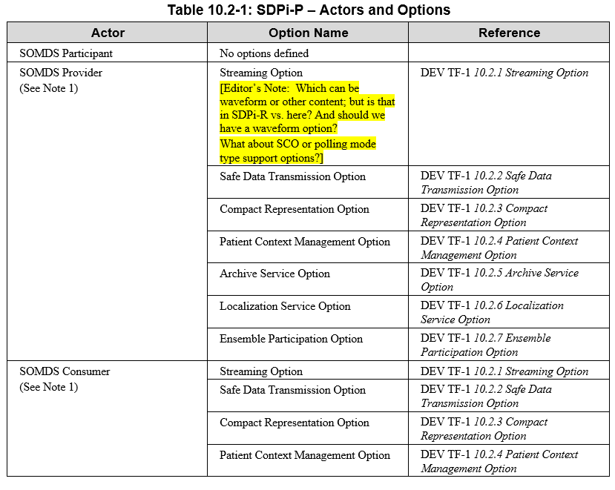
Orientation Tour: SDPi-P (Plug-and-Trust)
SDPi-P Actor Model
SDPi-P Options (partial)

Slide 19
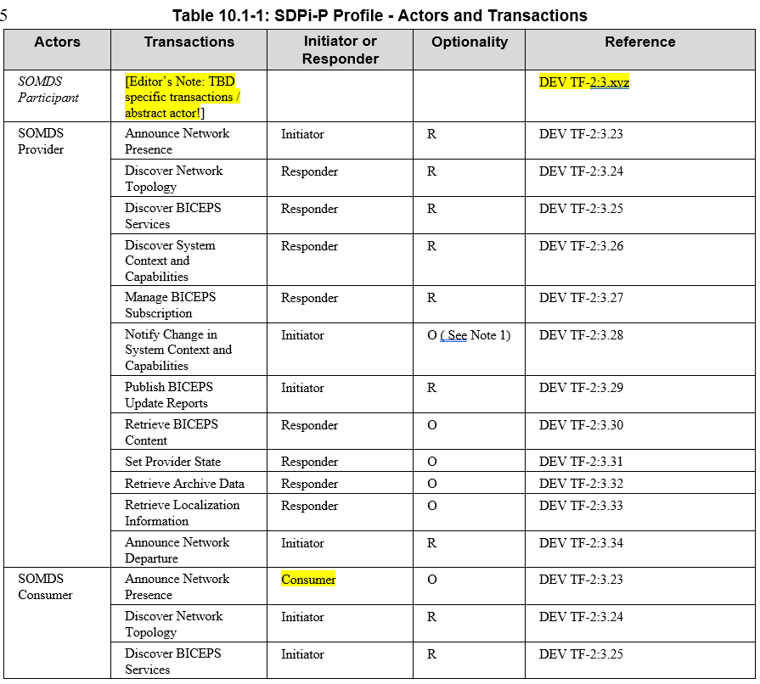
Orientation Tour: SDPi-P (Plug-and-Trust)
SDPi-P Actor Model
SDPi-P Transactions

Slide 20
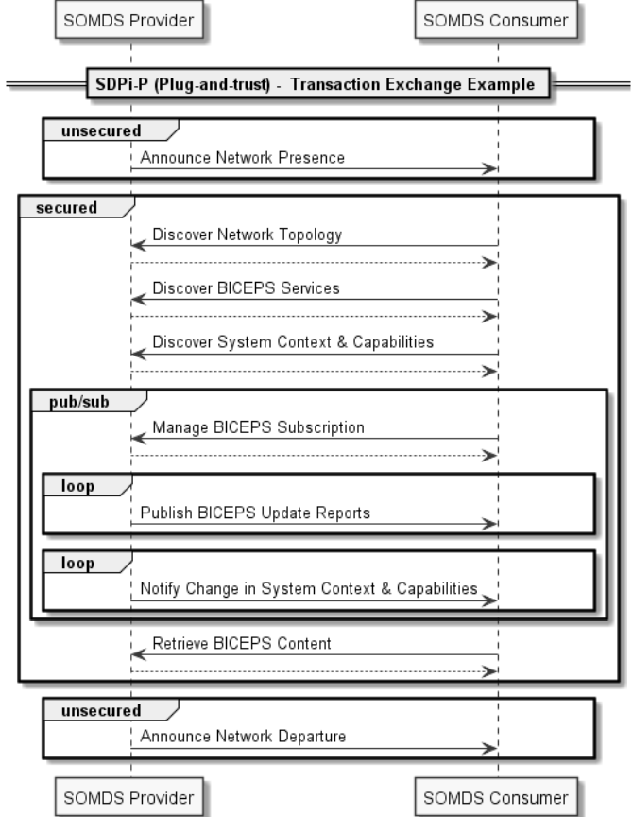
Orientation Tour: SDPi-P (Plug-and-Trust)
Example of an SDPi-P transaction exchange …
For a full set of profile-specific MDPWS sequence exchanges, see:
https://confluence.hl7.org/display/GP/SDPi+Technical+Framework+Models
NOTE: Definition of “BICEPS” abstraction level for SDPi transactions.

Slide 21
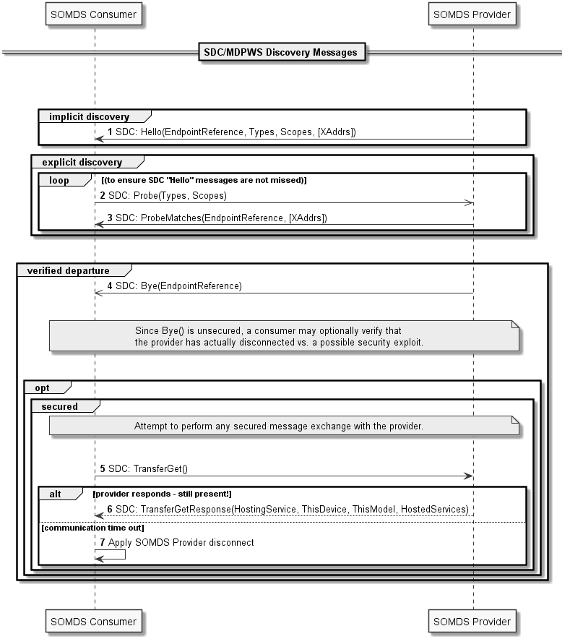
Orientation Tour: SDPi-P (Plug-and-Trust)
Example of an SDPi-P transaction MDPWS sequence …
For a full set of profile-specific MDPWS sequence exchanges, see:
https://confluence.hl7.org/display/GP/SDPi+Technical+Framework+Models

Slide 22
Orientation Tour: SDPi-R (Reporting)
SDPi-R Actor Model
NOTE: Transactions are drawn to the dotted box around the gateways, indicating that they can be either Provider and / or Consumer SDPi-R actors

Slide 23
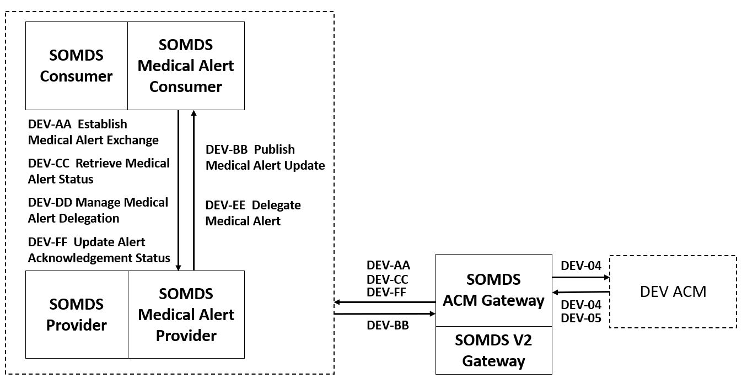
Orientation Tour: SDPi-A (Alerting)
SDPi-A Actor Model

Slide 24
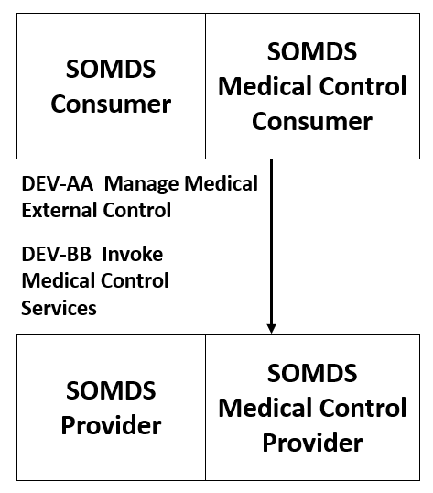
Orientation Tour: SDPi-xC (External Control)
SDPi-xC Actor Model

Slide 25
Real-world Narrative: Isolation ICU
Pandemic Patients in an Isolation ICU – EUA Remote Control Narrative
In dealing with severely infectious patients, healthcare workers (HCWs) are at a significantly greater risk of infection than the overall population due to their frequency and time in contact with the infected patients. The HCWs will enter the patient room to administer care to the patient and manage the therapeutic equipment. This management of the patient’s therapy may require frequent device adjustments which may be delayed due to the need for the HCWs to protect themselves by donning PPE prior to entering the patient room and doffing the PPE upon leaving. This donning and doffing processes can exceed 15 minutes depending on the specific PPEs used. A recent study (Suen, 2018) reported times of 7 minutes for donning and 10 minutes for doffing, with the doffing process providing the opportunity for “considerable” self-contamination.
Infectious diseases confer a synergistic burden on and risk to the patient due to the requirements for isolating the patient (Abad et al., 2010) including poorer care and impaired coordination of care, (Mehrotra et al., 2013), significantly fewer HCW and family visits (relative to patients not on precautions) (Morgan et al., 2013), increased rate of adverse events (Stelfox et al., 2003) and increased depression (compared to other inpatients). (Day et al., 2011). The use of remote control and monitoring can be used to eliminate some treatment delays, reduce the infection risk to the HCW, and help preserve the limited supplies of PPE and improve patient care.
Critically ill patients with an infectious disease will often require monitoring with physiologic monitors and therapeutic support with ventilators and infusion pumps. As previously explained, entering the room to view parameters or adjust any settings can require 15 minutes for something that may take less than 1 minute. Medical devices that support open interoperability technology can provide remote access to view parameters and adjust settings thereby increasing efficiency, saving the costs of the PPE and most importantly increasing the safety of the HCW.
Source: Adapted from AAMI CR Proposal: “Emergency Use Guidance for Remote Control of Medical Devices"

Slide 26
Real-world Narrative: Isolation ICU
Pandemic Patients in an Isolation ICU – Scenarios?
For the purposes of this PAT, what scenarios are of greatest interest?
Participant Discovery / Security / Service Exchange?
Patient / Participant Association (Patient & Location & Workflow context establishment)?
Alert delegation / Alert Limit Adjustment / Alert confirmation / Silence ... ?
Which devices, systems, applications? Monitors, vents, pumps, central … others?
Integration with EHR or other system?
Use of IHE-based FHIR profiles for integration with non-SDPi / non-SDC SOMDS systems?
…
Other Use Cases / Scenarios? (e.g., surgery focused)

Slide 27
SDC/SDPi PAT – Objectives
1st IHE SDPi Testing Event!!!
Build SDC / SDPi Competency for Implementer Community
Validate SDPi Profiling Approach (Actors & Transactions & SDC …)
Advance SDC / SDPi Testing & Tooling strategy into 2021!

Slide 28
Additional
Information

Slide 29
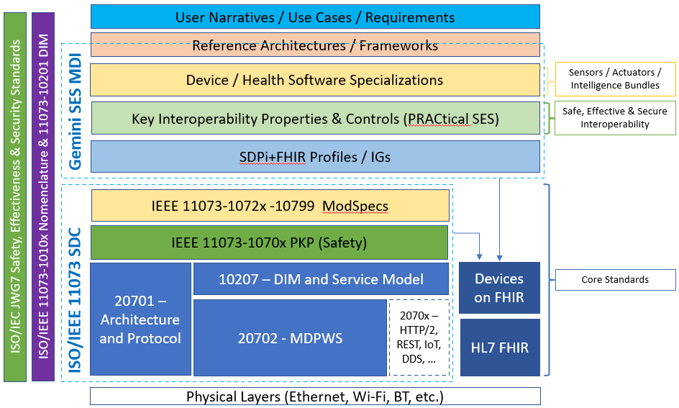
Hanging Gardens: After SDPi 1.0 …
NOTE: Profile Titles are notional – hopefully useful too!
Devices-In-Care (PDP) Profile
Device Specialization Profile
Surgery PoC Profile
ICU PoC Profile
MDIRA ICE Profile
SOMDS@home Profile
IHE (Official) Profile Types:
Transport, Content, Workflow
Or a combination of all (3)
Other types?
Architecture (SOA, MDIRA, SDC, ….?
Single domain / multi-domain?

